Slide 1
Russia——
Long-term development strategy
The use of SWF and the vote consideration
_World_Economic_
Presenter Adam
Notes:
Today I want to talk something about my understanding of the world economic. My topic is Russia——Long-term development strategy.

Slide 2
Agenda
WHY
How
Dilemma
Why are we choosing the SWF.
How to establish a sufficient
SWF.
The vote conflict between traditional energy and renewable one
Notes:
It contains three parts.

Slide 3
WHY SWF
01
Sovereign Wealth Fund is the standard choice for all oil-rich countries.
Notes:
So the first part is why we choose the SWF? Is it because the SWF is the standard choice for all oil-rich countries? I’m supposed not.

Slide 4
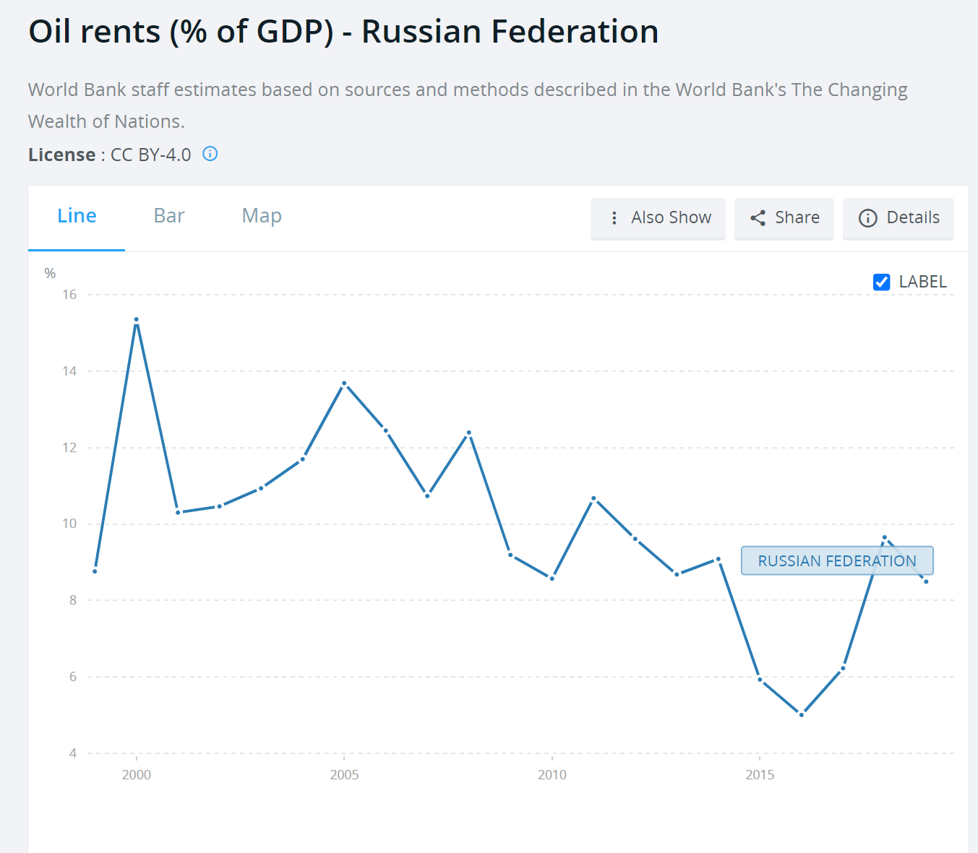
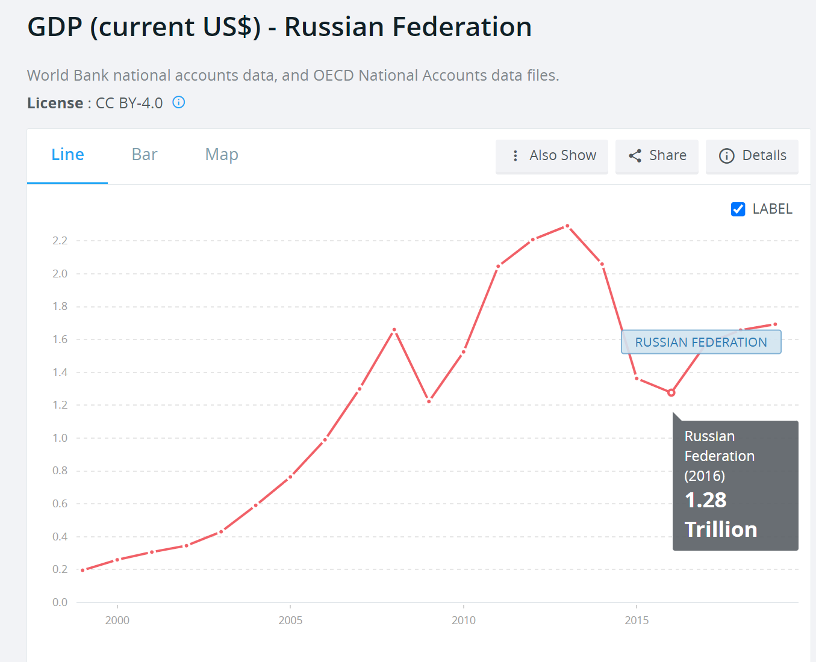
The oil sector
Period: 1999-2019
OIL RNET
&
GDP
Pugin came to power
Positive correlation
Before the Russian-Ukrainian war
Vital important
WHY SWF
HOW TO DO
DILEMMA
Notes:
To confirm the idea, I searched the GDP and the oil rents share of GDP between 1999 to 2019, when Pugin came to power and before the Russian-Ukrainian war.
And from the image, we can find that, the oil rent effects the GDP, especially in this time
So we can make the conclusion that the oil rent and the GDP in a positive correlation and the oil sector is vital important

Slide 5
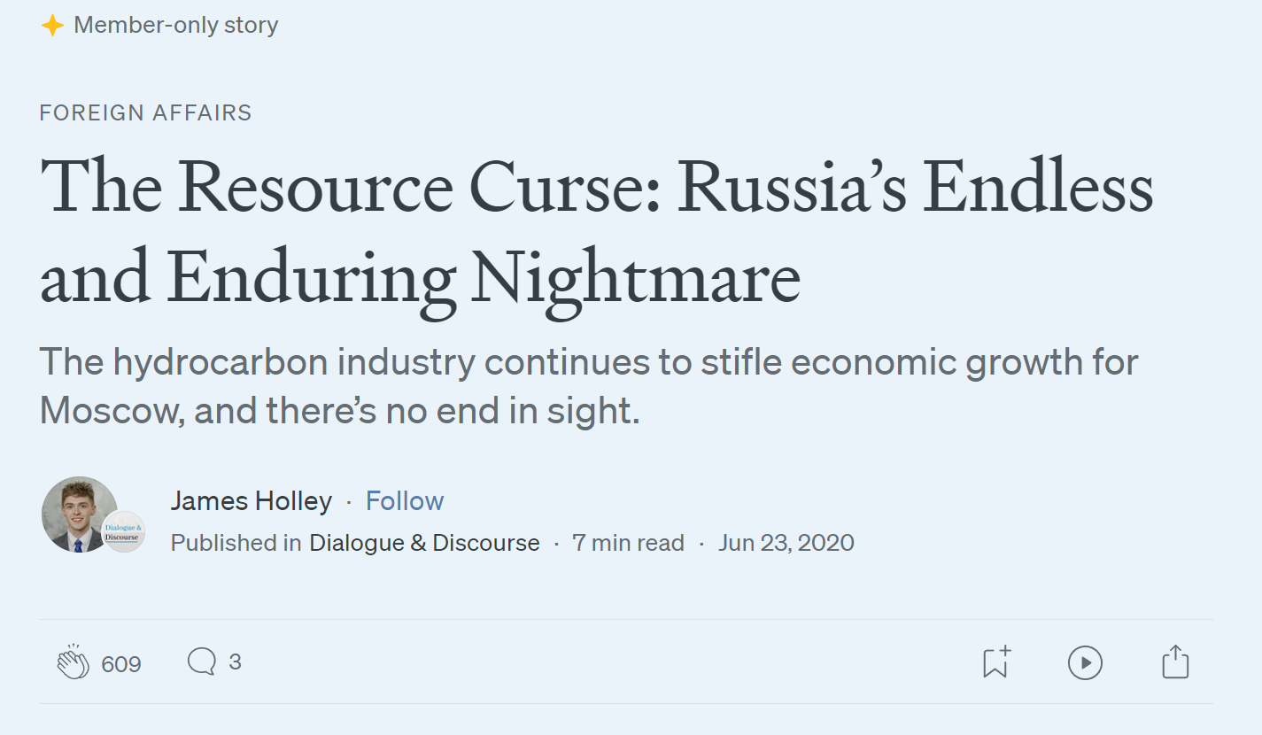
Natural resource “curse”
Why cursed?
a. Economic dependence;
b. Corruption and rent-seeking;
c. Dutch disease
There exists a natural resource “curse.” in Russia.
WHY SWF
HOW TO DO
DILEMMA
Notes:
Then there exists a natural resource “curse ” in Russia. The reason may be the economic dependence, corruption and rent-seeking and dutch disease.
Dutch disease: natural resources can cause a rapid appreciation of the country's currency, making other sectors, such as manufacturing and agriculture, less competitive.

Slide 6


The world experience
&
Two
Type
.
Failed SWF.
Successful SWF .
The success can conduct meaningful guidance for Russia fund, which enables it to grow faster
The funds that did not do well in this field can also provide experience
WHY SWF
HOW TO DO
DILEMMA
Notes:
Finally, there are some successful SWF and failed SWF to know. On the one hand, a successful one can conduct meaningful guidance for us. On the other hand, failed SWF can also provided experience.

Slide 7
HOW TO DO
02
The essential theoretical guidance is the Truman score
Notes:
Now we know why we choose the SWF. So the next question is how to establish a sufficient one ? Luckily, there is a excellent method to measure it, the Truman score

Slide 8
The Truman score
Structure
Transparency & accountability
Investment strategy
...
Source of funding ...
01
02
Report and audit
...
Investment
...
03
04
Governance
Behaviour
Ethical guidelines
…
Separate from the international reserves ...
Enhance the speed of adjustment
WHY SWF
HOW TO DO
DILEMMA
Notes:
It contains four parts and many points in each part.
I have abstract the data in each aspects of Russia, and now let’s have a look at it

Slide 9
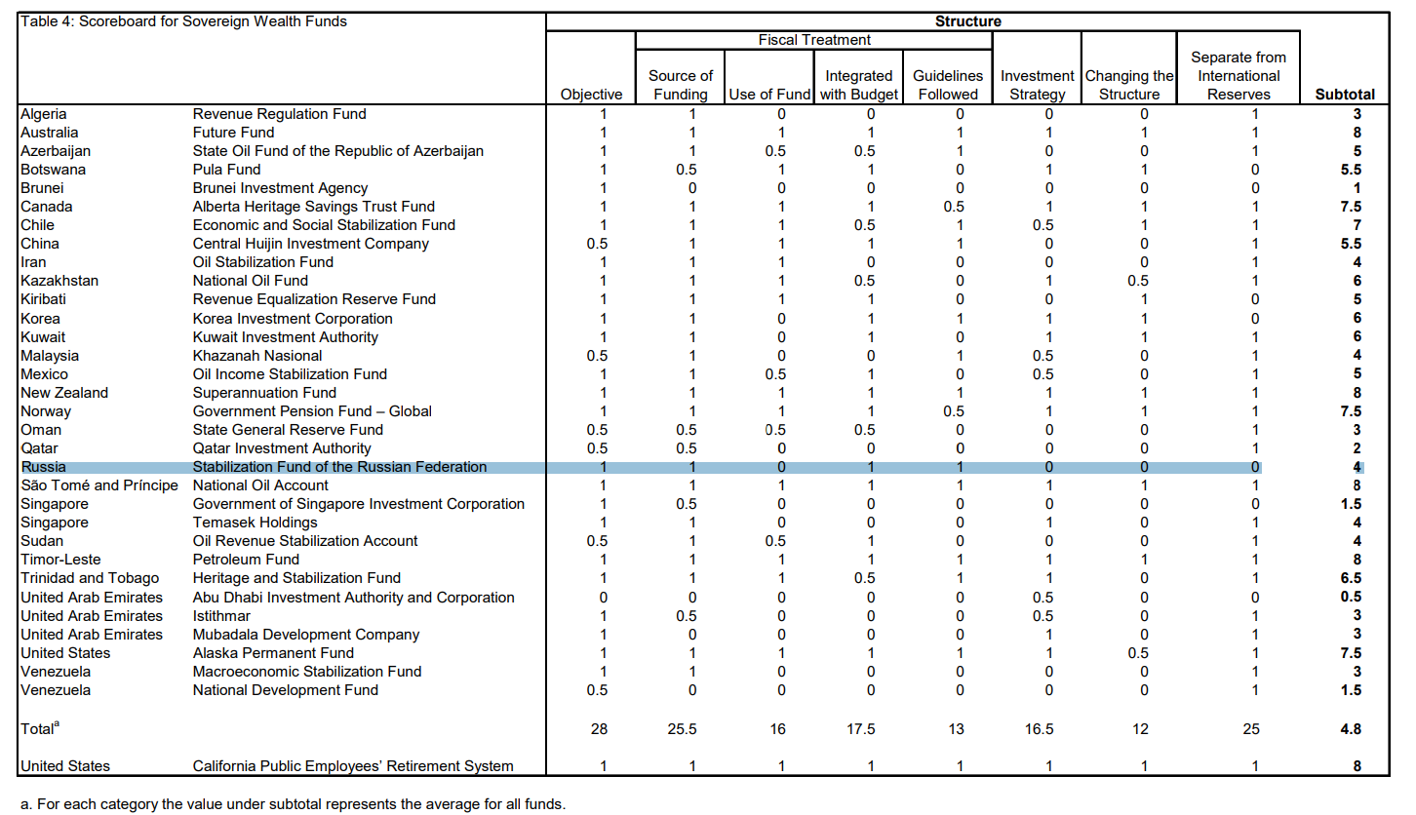
Structure
Sufficient
Improve
Investment strategy
Separate from the international reserves
WHY SWF
HOW TO DO
DILEMMA
Notes:
The structure part has a score of 4, which is a sufficient one, so we can apply the methods to improve, for example developing the investment strategy and separate the international reserves

Slide 10
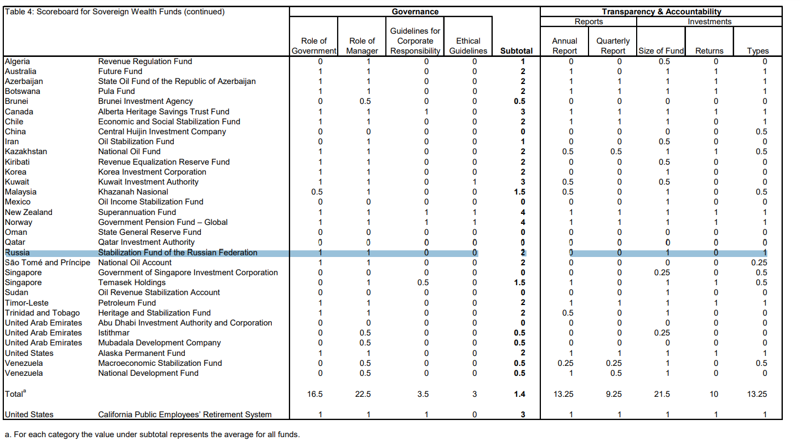
Governance
Sufficient
Improve
Ethical guidelines
Guidelines for corporate responsibility
WHY SWF
HOW TO DO
DILEMMA
Notes:
Meanwhile, the governance part is also sufficient, and we can create some ethical guidelines and corporate responsibility guidelines to improve it

Slide 11
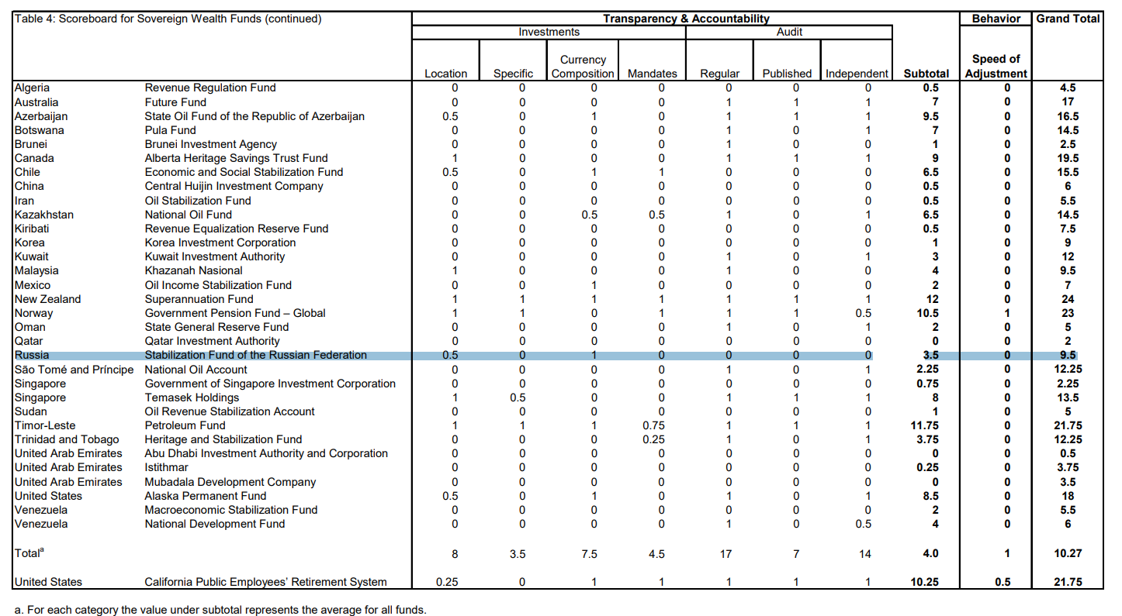
Transparency & accountability
Insufficient
Correct
Report
Investment
Audit
WHY SWF
HOW TO DO
DILEMMA
Notes:
But in the transparency and accountability level, it is insufficient. For example, the lack of annual report and the quarterly report, the investment plan and the audit
The more transparency there is, the less corruption will have.

Slide 12
Behaviour
Insufficient
Correct
Enhance the speed of adjustment
WHY SWF
HOW TO DO
DILEMMA
Notes:
Finally, the behavior level should be correct like enhancing the speed of adjustment. Action maybe set a specific sector to response the risk.

Slide 13
DILEMMA
03
The conflict of traditional energy and the renewable energy
Notes:
All above, is the reason why we use SWF and how to establish a sufficient one. The next part is about the dilemma when there is a conflict between traditional energy and renewable energy

Slide 14
Vote conflicts
Different generations Distribution.
Old generation
Young generation
Fond of the oil
And vote for the oil government
Love the green energy
And support the “green” government
If the government cannot handle it well
It would lose the election
WHY SWF
HOW TO DO
DILEMMA
Notes:
The old generation are fond of the oil market and the young generation love the green energy and each parts are strong affect the election. So the government should handle it well or it will lose the election

Slide 15
Methods for it
Education and awareness
Subsidy renewable industry
It will be easy if the next generation has the awareness of “green”
Promote communication
The traditional one has the power to reform
Having an understanding of each other benefits
WHY SWF
HOW TO DO
DILEMMA
Notes:
There are three methods to apply. To begin with, we should promote communication between them, letting them know each other’s stand view Then we can subsidy the renewable industry, helping the old to reform. At last, we ‘d better focus on the education and green awareness of the next generation.

Slide 16
Thank You
_World_Economic_
Presenter Adam

