Slide 1
演讲人：刘敬文

Slide 2
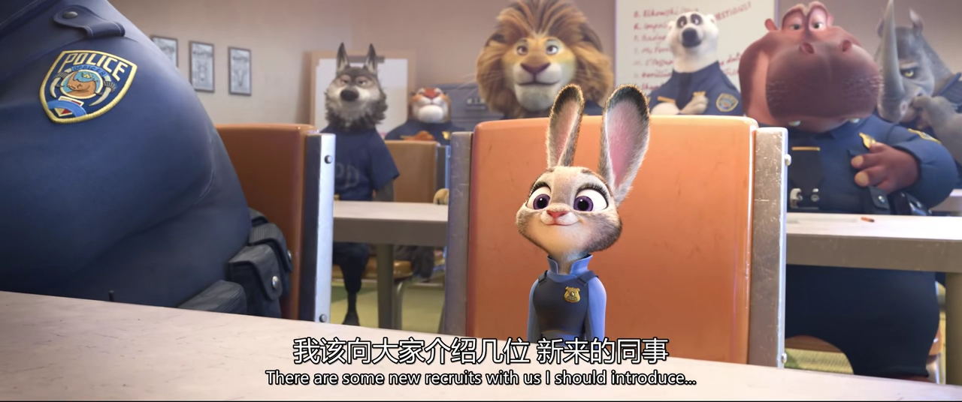

Slide 3
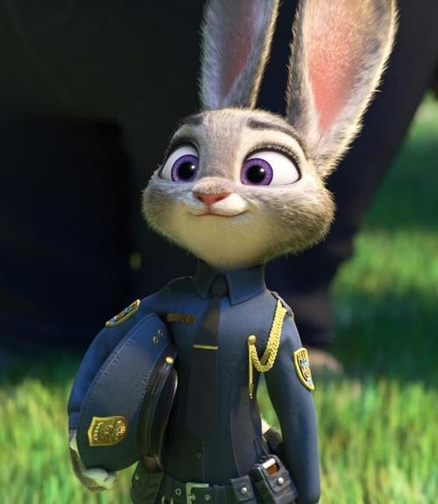
a new recruit in the police office
recruit newcomer
v. 征募;聘用
n.招聘 ; 新成员;新兵

Slide 4
Q1：How many items are placed on the docket by 1111Chief Bogo？
Q2：which items is the priority number one？
A.Today is elephant’s（Francine）birthday.
B.Introduce some new recruits.
C.14 missing mammal cases happended so they need to find the
missing predators.

Slide 5
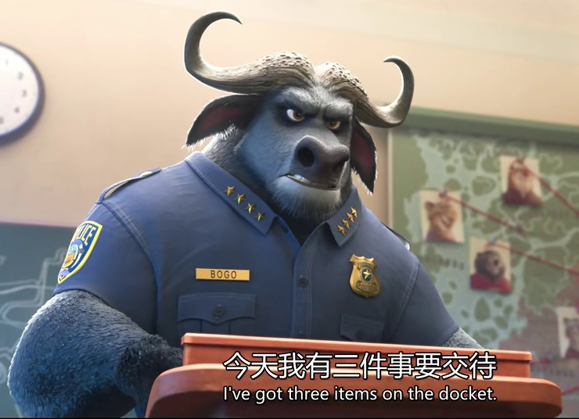
on the docket
something is being researched / surveyed
近义词：在审查中/在审理中
on the fire/on the carpet
be placed on the docket
列入议事日程

Slide 6
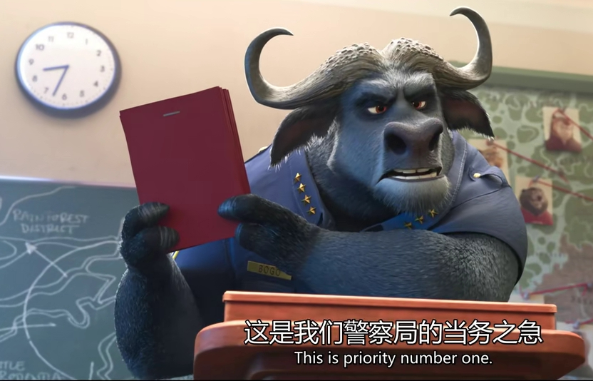
priority
n. 优先权；优先；优先考虑的事
you have special rights to finish something ahead of time.
近义词：precedence

Slide 7
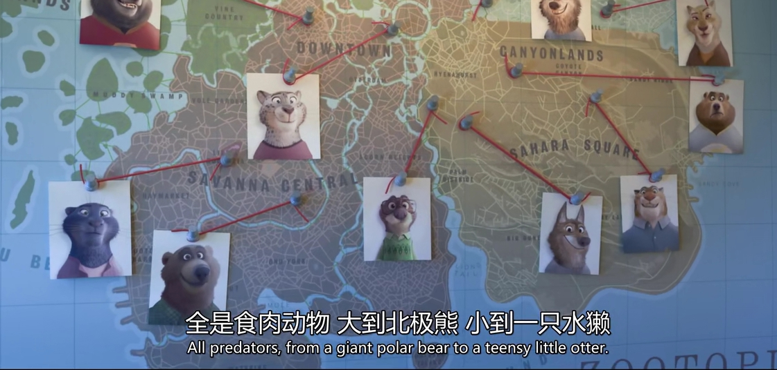
mammal
n.【脊柱】
哺乳动物

Slide 8
Q3：What is Judy’s main responsibility 1111when Chief Bogo assigning the items?
A. To handle a part of the missing mammal cases.
B. doing the parking duty.
C. To celebrate Francine’s birthday.

Slide 9
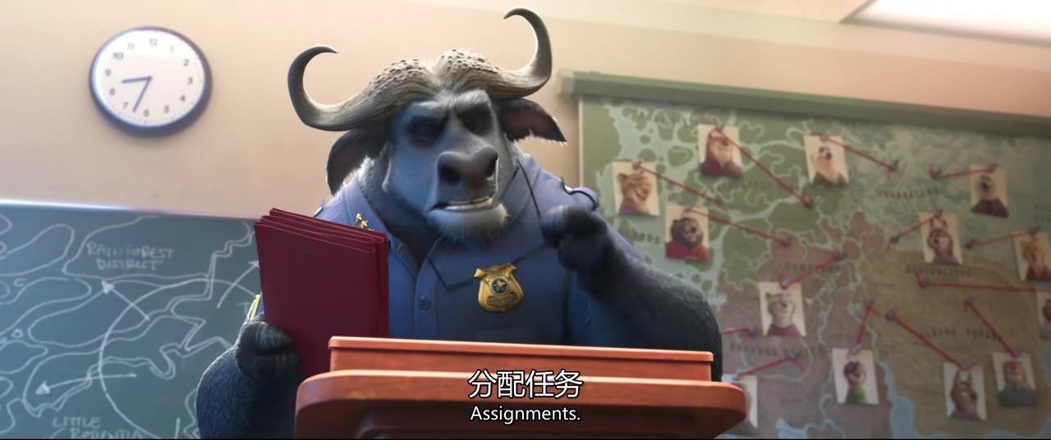
assign
v. 分配 ; 指派
give out / allot (tasks)
assignment
n.分配；任务；作业；功课

Slide 10
感谢观看
thanks for watching

Slide 11
token
taken
adj. 装样子的；作为标志的；
象征性当选的
n. 象征性代表；礼券；标志；标记

