Slide 1
Energy and food crises
十二组
汇报人：刘玲

Slide 2
CONTENTS
1 News
2 Lead in
3 Text
4 Connection

Slide 3
Listen carefully and grasp the main idea of the news.
Request
1 News

Slide 4
1 News
Listening
Part 1
Researchers believe they have found a previously unknown kind of whale in waters off Mexico's western coast.If others confirm the finding,the new whale would be an important discovery among giant animals.The team of researchers came upon three unusual whales while following a rare group of beaked whales on Nov. 17.The whales were near Mexico's distant San Benito Islands,about 500 km south of the U.S. border.Beaked whales usually avoid contact with humans.
研究人员认为，他们在墨西哥西海岸海域发现了一种前所未知的鲸鱼。如果其他人证实这一发现，
那么这个鲸鱼新物种将是大型动物领域内的一个重要发现。该研究小组在11月17日跟踪一群罕见的喙鲸时，发现了三只不同寻常的鲸鱼。这些鲸鱼出现在墨西哥遥远的圣贝尼托群岛附近，
位于美国边境以南约500公里处。喙鲸通常避免与人类接触。

Slide 5
1 News
Listening
Part 2
Jay Barlow studies sea animals at the Scripps Institution of Oceanography in San Diego.He said, "These animals popped to the surface right next to the boat."He noted that it was a very unusual meeting."It's very rare to even see a beaked whale,“and to find a friendly group of beaked whales, it's even rarer," he said.Barlow said he and other researchers did not realize they were seeing a possible new kind of whale until later.The group, led by the non-profit Sea Shepherd Conservation Society,saw something different about the whales' teeth when they studied photos they took of the animals.The underwater recordings of the whales' calls also suggested they were different from all others.
杰伊·巴洛在圣地亚哥的斯克里普斯海洋研究所研究海洋动物。他说：“这些动物就在船边蹿出了水面。”他指出，看到这些鲸鱼新物种非常不寻常。“看到喙鲸都非常罕见，而找到一群友好的喙鲸就更罕见了”，他说。巴洛说，直到后来，他和其他研究人员才意识到他们所看到的可能是一种全新的鲸鱼物种。这个由非营利性组织海洋守护者协会领导的团队，在研究他们所拍摄的鲸鱼照片时发现它们牙齿有所不同。鲸鱼叫声的水下录音也表明它们和其它所有鲸鱼不同。

Slide 6
1 News
Listening
Part 3
The researchers are now waiting for test results on water they collected near the whales.There could be skin cells in the water from the whales.If so, they will examine the DNA to confirm whether the whales are a new species.Beaked whales get that name because of their pointy noses.They live mostly in waters far away from the mainland,such as off the San Benito Islands.Though up to 5 meters long, they can be hard for scientists to see.That is because they usually swim and eat at depths of around 914 meters.They only come up at times for air.In the deep water, the animals can stay away from their main enemy, killer whales.
研究人员正在等待他们在鲸鱼附近收集到的水的测试结果。水里面可能有鲸鱼的皮肤细胞。如果是那样的话，他们将检查其DNA以确定这些鲸鱼是否是一个新物种。喙鲸因其尖尖的鼻子而得名。它们大多生活在远离大陆的水域，比如圣贝尼托群岛附近。虽然它们长达5米，但科学家很难看到它们。那是因为它们通常在水深914米的地方游动和进食。它们只是偶尔浮上来换气。在深水中，这些动物可以远离它们的主要敌人——虎鲸。

Slide 7
1 News
Listening
Part 4
Andrew Read is a marine biologist at Duke University.He said, "The fact that they were looking for a very rare whale,and that they happen to find something completely different,is remarkable and wonderful, and just the joy of doing science.That's what we all live for."Read said that finding a new species is a rare event.Barlow's team has evidence about the whales that looks like a new discovery.Read said the DNA testing would help confirm it.Barlow was hopeful about the chance of confirming the beaked whales as a new species.That would bring the number of known beaked whale species to 24.Barlow said the whales are as big as a horse.He noted that it is hard to imagine people not seeing something that big on land,"But there's a lot of mysteries in the sea."I'm Jill Robbins.
安德鲁·里德是杜克大学的海洋生物学家。他说：“事实是，他们在寻找一种非常罕见的鲸鱼，而他们碰巧发现了一种完全不同的生物，这非常了不起，很棒，而那正是从事科学研究的乐趣。那是我们活着的目的。”里德说，发现新物种是一件罕见的事情。里德说，发现新物种是一件罕见的事情。巴洛的团队有关于这种鲸鱼的证据，那使这看起来像是一项新发现。里德说，DNA测试将有助于确认这一点。巴洛对确认这种喙鲸为新物种充满希望。那将使已知的喙鲸物种总数达到24种。巴洛说，这种鲸鱼像马一样大。他指出，难以想象，人们在陆地上看不到这么大的东西，“但海洋中有很多神秘事物。”吉尔·罗宾斯为您播报。

Slide 8
Watch the video carefully and think about the questions deeply.
Demand
2 Lead in

Slide 9
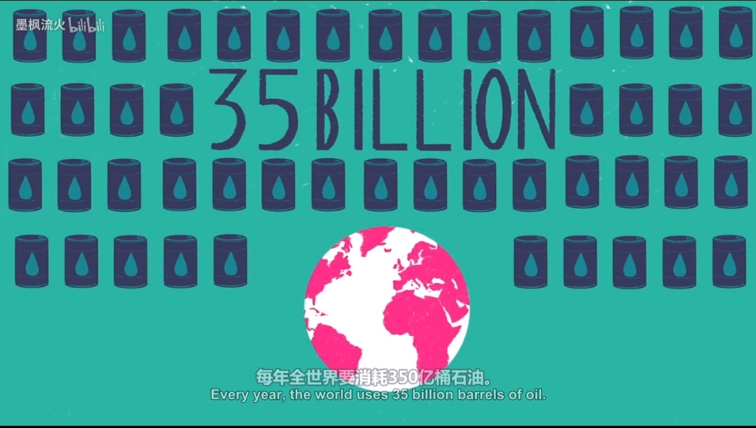
2 Lead in
question 1
Why we urgently need to reduce our dependence on fossil fuels?
question 2
点击此处添加标题
What are the biggest challenges facing the large-scale use of renewable energy?

Slide 10
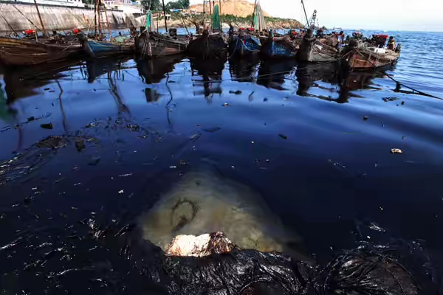
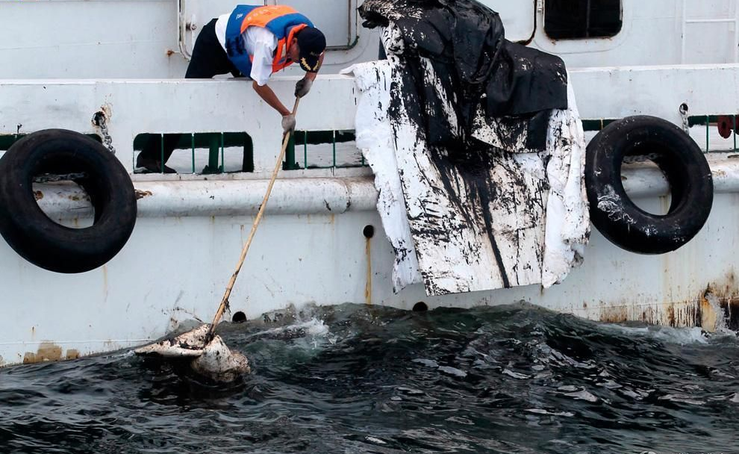
2 Lead in
Question 1
Question 2
answer
1.The massive scale of fossil fuel dependence pollutes the Earth and threatens our health.
2. The amount of fossil fuels is drastically decreasing.
answer
The cost is too high, the technology is not efficient enough and economical.

Slide 11
turn to page 191 and complete the following three tasks（reading details、translation、critical thinking）.
Requirement
3 Text

Slide 12
3 Text
Reading detail
Qusetion 1
Q: Which parts can the article be divided into? What is the main idea of each part?
A: Three parts. The frist part (1-3) introduces the traditional non-renewable fossil fuels such as oil, coal, oil, natural gas and so on. At the same time, it tells us that these fuels will eventually be exploited and exhausted. We need to be prepared for the arrival of the new energy era and develop renewable energy. The second part (4-8) introduces the advantages and disadvantages of solar energy, wind power, hydroelectric power, biomass energy. The last part (9) compares the advantages and disadvantages of renewable energy and non-renewable energy in terms of economic benefits, and draws the conclusion that we should act as soon as possible, seek international cooperation and find the most effective solution to the energy problem.

Slide 13
3 Text
Reading detail
Qusetion 2
Q: Besides the ideas listed in the above questionnaire, what else do you think we can do to help conserve energy?
A: There are many other things we can do to save energy, such as:
·Not to overheat or overcool our rooms.
·Reduce the amount of waste we produce by buying minimally packaged goods.
·Choose reusable products over disposable ones,and recycle.
·Plan carefully and cluster our errands and shopping to minimize the miles we drive.
·Use less hot water by installing low-flow shower heads.
·Install a solar water heater for our home.
·Drive a pure electric car(with a back-up generator for out-of-range driving).
·Walk or ride a bicycle whenever we can.

Slide 14
3 Text
Reading detail
Qusetion 3
Q: Is it important to conserve energy? Why do you think so?
A: Yes, it's definitely important to conserve energy. There are several reasons. First, it reduces our consumption of fossil fuels which have fixed quantity of availability and are rapidly diminishing. Second, it saves us money because we don't have to build more power plants. Third, it reduces carbon emission, which will contribute greatly to the improvement of our air quality and natural environment.

Slide 15
3 Text
Reading detail
Qusetion 4 & 5
Q: What are the problems of nuclear power according to Paragraph2?
A: (1) Nuclear power is not really cheap when all costs are considered;
(2) Disastrous nuclear accidents could happen;
3) Nuclear waste can be used improperly to cause damage.
Q: What point does the author want to illustrate by telling us the advantages and disadvantages of different renewable energy sources?
A: The point the author wants to illustrate is: Although renewable energy sources are promising, there are still various problems with these "new energy" technologies. The greatest problem is to find ways to use these technologies more efficiently and at lower costs.

Slide 16
3 Text
Reading detail
Qusetion 6
Q: According to the author, what is the best solution to the world's energy problem?
A: According to the author, the best solution to the world's energy problem must come from various energy technologies that are non-damaging to the environment, rather than from any single technology.

Slide 17
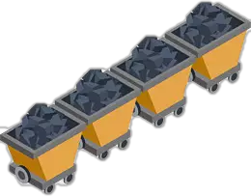
3 Text
Translation
At some indefinite time in the near future, the last drop of oil, lump of coal or wisp of natural gas will be collected from the earth. The eventual depletion of fossil fuels that hitherto proved so reliable has left us with no choice but to prepare for a new age of energy synthesis. (para 3)
在不久的将来的某个时候，地球上最后一滴石油、最后一块煤或最后一缕天然气将被开采。迄今为止一直被证明是稳定可靠的矿物燃料终将消失，这让我们别无选择，只能作好准备，迎接新的能源综合利用时代的到来。

Slide 18
3 Text
Translation
The solar apparatus itself is ready for many new business and consumer applications, but it is way too expensive to replace the old combustion machinery of gears and motors with new electronic technology of semiconductors and transistors on a global or even a national scale. (para 5)
太阳能设备本身已是技术成熟，可以使商业和消费者进行许多新型应用，但是，在全球或者即便是在全国范围内，用新型的半导体和晶体管电子技术取代老式的用齿轮和发动机驱动的燃烧设备，其成本实在太高。

Slide 19
3 Text
Translation
Organic waste in the form of dead trees, leaves, animal corpses and food processing waste exists in abundance and can be used to produce energy. (para 8)
以死树、枯叶、动物尸体以及食品加工废料的形式存在的有机废物十分充足，可以被用来制造能源。

Slide 20
3 Text
Do you agree with the author's discussion and comparison of the advantages and disadvantages of renewable energy and non-renewable energy? If not, what's your point of view? What do you think is the best solution to the energy crisis in the future? (Free response，please)
Critical thinking

Slide 21
introduce some relavant and meaningful information.
instruction
4 Connection

Slide 22
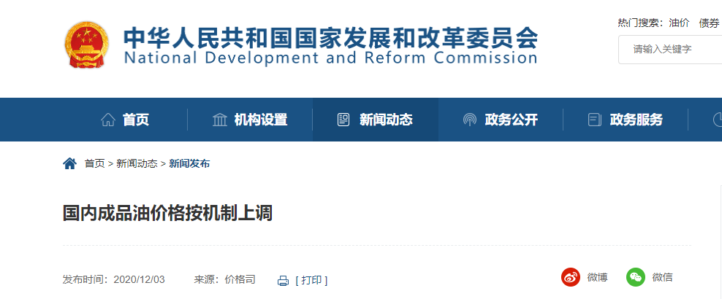
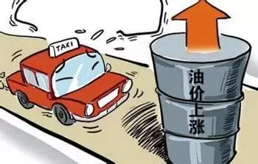
4 Connection
Background
According to the general estimation of economists and scientists, by the middle of this century, that is, around 2050, the oil resources will be exhausted, and the price will rise to a very high level.

Slide 23
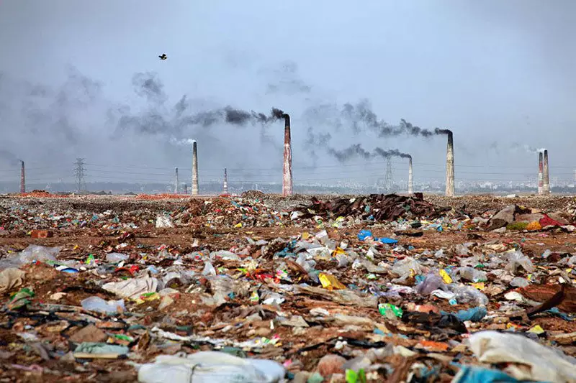
4 Connection
Detriment
Energy shortage, resource competition and environmental pollution caused by excessive use of energy threaten the survival and development of human beings

Slide 24
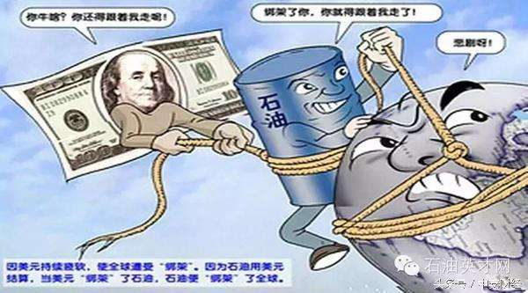
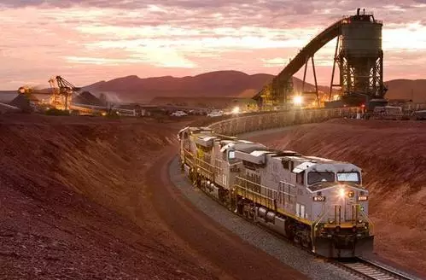
4 Connection
Measures
China's measures to deal with energy crisis: 1. Strive to expand energy sources, such as Sino Russian oil pipeline(中俄石油管道), and Middle East oil import(中东石油进口). 2. Invest in foreign energy, such as Afghanistan and Sudan. Coal mines in Mongolia. 3. Subsidies to promote the development of domestic new energy enterprises.

Slide 25
THANK YOU

